Slide 1

CHAPTER 9
COUNTING AND PROBABILITY
Copyright © Cengage Learning. All rights reserved.

Slide 2

9.3
Counting Elements of Disjoint Sets: The Addition Rule
Copyright © Cengage Learning. All rights reserved.

Slide 3
Counting Elements of Disjoint Sets: The Addition Rule
In this section we look at counting problems that can be solved by counting the number of elements in the union of two sets, the difference of two sets, or the intersection of two sets.
The basic rule underlying the calculation of the number of elements in a union or difference or intersection is the addition rule.

Slide 4
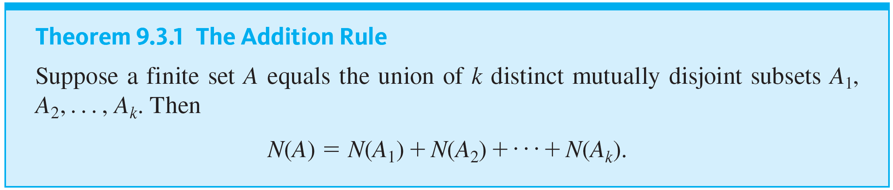
Counting Elements of Disjoint Sets: The Addition Rule
This rule states that the number of elements in a union of mutually disjoint finite sets equals the sum of the number of elements in each of the component sets.

Slide 5
Example 9.3.1 – Counting the Number of Integers Divisible by 5
How many three-digit integers (integers from 100 to 999 inclusive) are divisible by 5?

Slide 6
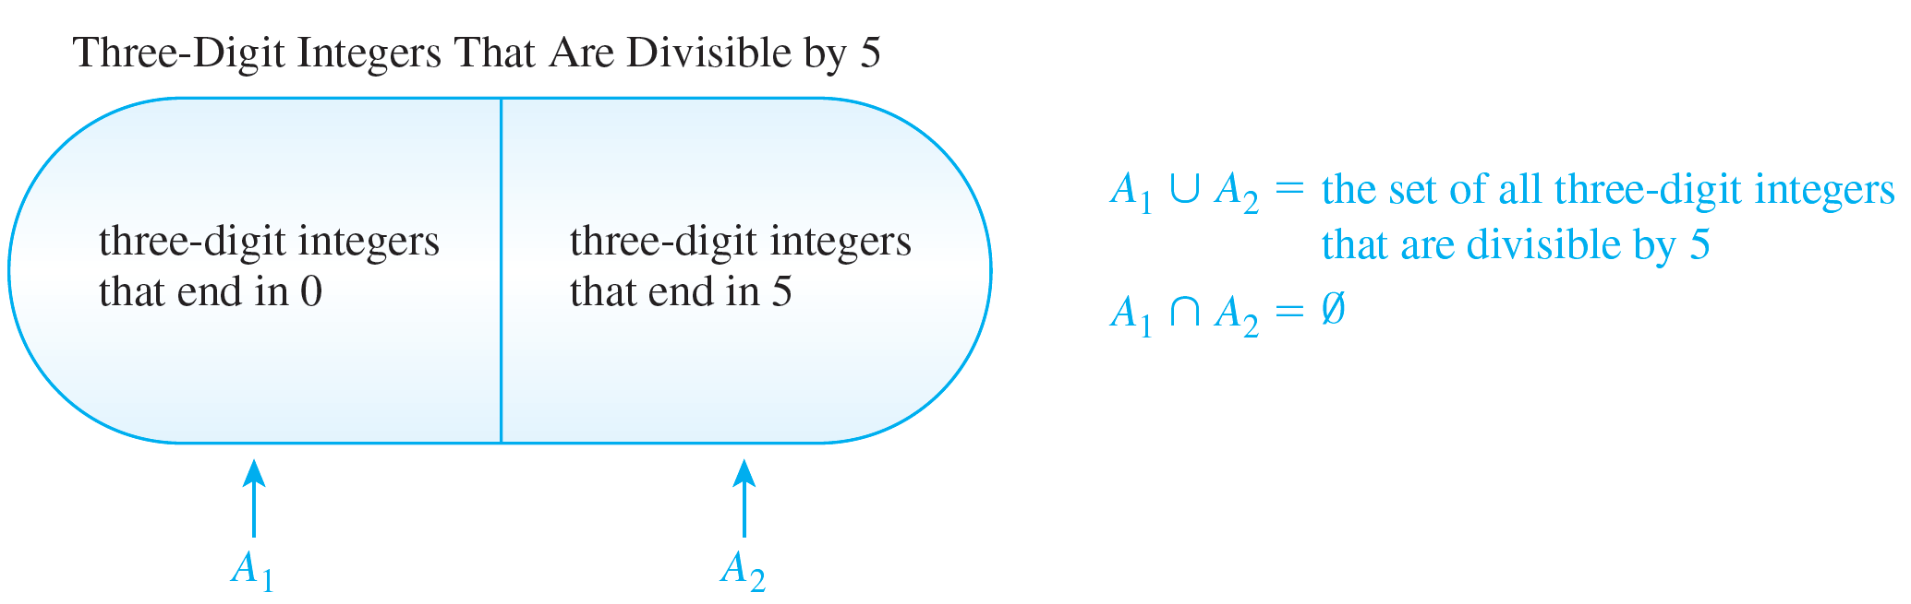
Example 9.3.1 – Solution
The solution to this problem uses the addition rule. Integers that are divisible by 5 end either in 5 or in 0. Thus the set of all three-digit integers that are divisible by 5 can be split into two mutually disjoint subsets A₁ and A₂ as shown in Figure 9.3.1.
Figure 9.3.1

Slide 7
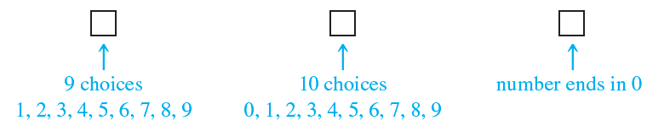
Example 9.3.1 – Solution
continued
Now there are as many three-digit integers that end in 0 as there are possible choices for the left-most and middle digits (because the right-most digit must be a 0).
As illustrated below, there are nine choices for the left-most digit (the digits 1 through 9) and ten choices for the middle digit (the digits 0 through 9). Hence N(A₁) = 9 · 10 = 90.

Slide 8
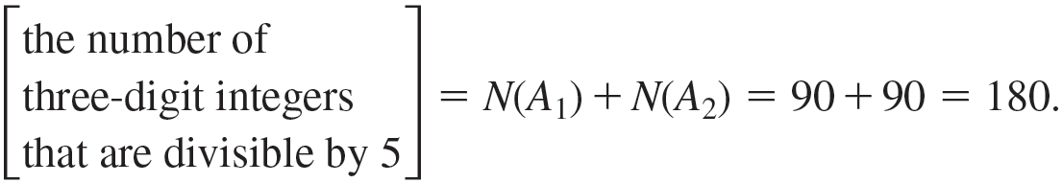
Example 9.3.1 – Solution
continued
Similar reasoning shows that there are as many three-digit integers that end in 5 as there are possible choices for the left-most and middle digits, which are the same as for the integers that end in 0.
Hence, N(A₂) = 90. So

Slide 9
The Difference Rule

Slide 10
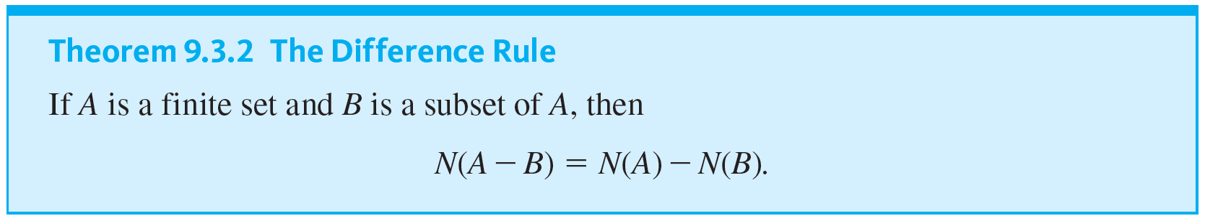
The Difference Rule
An important consequence of the addition rule is the fact that if the number of elements in a set A and the number in a subset B of A are both known, then the number of elements that are in A and not in B can be computed.

Slide 11
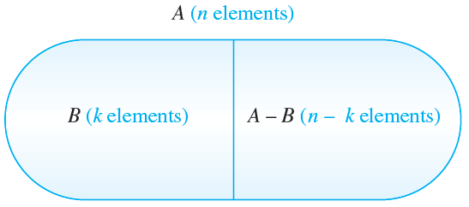
The Difference Rule
The difference rule is illustrated in Figure 9.3.2.
The Difference Rule
Figure 9.3.2
The difference rule holds for the following reason: If B is a subset of A, then the two sets B and A − B have no elements in common and B ∪ (A − B) = A.

Slide 12
The Difference Rule
Hence, by the addition rule,
N(B) + N(A − B) = N(A).
Subtracting N(B) from both sides gives the equation
N(A − B) = N(A) − N(B).

Slide 13
Example 9.3.2 – Counting PINs with Repeated Symbols
Consider the personal identification numbers (PINs). These are made from exactly four symbols chosen from the 26 uppercase letters of the Roman alphabet and the ten digits.
There are 1,679,616 PINs with repetition allowed and 265,896 PINs with no repeated symbol.
a. How many PINs contain at least one repeated symbol?
b. If all PINs are equally likely, what is the probability that a randomly chosen PIN contains at least one repeated symbol?

Slide 14
Example 9.3.2 – Solution
a. Let S be the set of all the PINs with repetition allowed, and let A be the set of PINs with no repeated symbol. Then S − A is the set of PINs with at least one repeated symbol, and, by the difference rule,
N(S − A) = N(S) − N(A)
= 1,679,616 − 1,413,720
= 265,896.
Hence, there are 265,896 PINs that contain at least one repeated symbol.

Slide 15

Example 9.3.2 – Solution
continued
b. Solution 1: Because there are 1,679,616 PINs in all and 265,896 of these contain at least one repeated symbol, by the equally likely probability formula, the probability that a randomly chosen PIN contains a repeated symbol is
Solution 2: P(A) is the probability that a randomly chosen PIN has no repeated symbol, and so P(S − A) is the probability that a randomly chosen PIN has at least one repeated symbol.

Slide 16


Example 9.3.2 – Solution
continued
Then
by definition of probability in the equally likely case
by the difference rule
by the laws of fractions
= 1 − P(A) by definition of probability in the equally likely case

Slide 17
Example 9.3.2 – Solution
continued
≅ 1 − 0.842 by Example 9.2.2
≅ 0.158
= 15.8%.

Slide 18
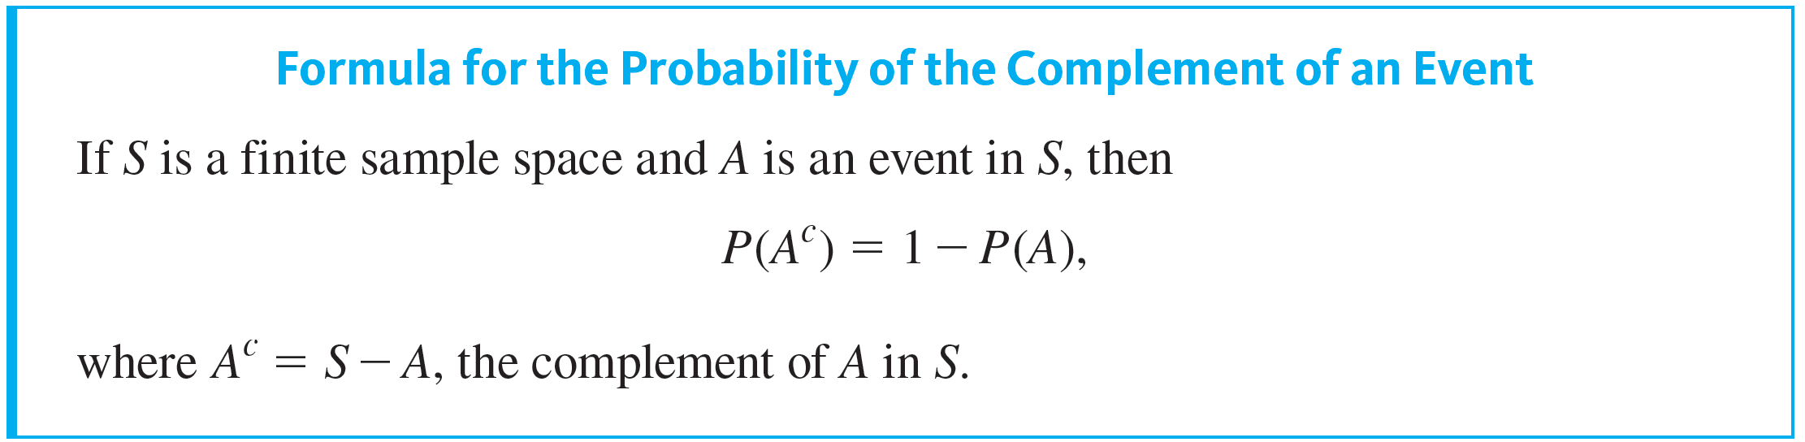
The Difference Rule

Slide 19
Example 9.3.3 – Passwords with 3-5 Letters
A certain computer access password consists of 3 through 5 uppercase letters chosen from the 26 letters in the Roman alphabet, with repetitions allowed.
a. How many different passwords are possible?
b. How many different passwords have no repeated letter?
c. How many different passwords have at least one repeated letter?
d. If all passwords are equally likely, what is the probability that a randomly chosen password has at least one repeated letter?

Slide 20
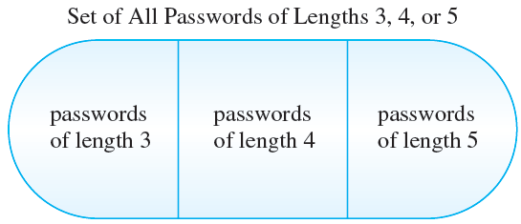
Example 9.3.3 – Solution
a. The set of all passwords can be partitioned into three subsets consisting of passwords with lengths 3, 4, and 5, as shown in Figure 9.3.3.
Figure 9.3.3

Slide 21
Example 9.3.3 – Solution
continued
By the addition rule, the total number of passwords equals the number with length 3, plus the number with length 4, plus the number with length 5.
The multiplication rule can be used to compute the number of passwords of each length. Thus the
because forming such a password can be thought of as a three-step process with 26 ways to perform each step

Slide 22

Example 9.3.3 – Solution
continued
because forming such a password can be thought of as a four-step process with 26 ways to perform each step
because forming such a password can be thought of as a five-step process with 26 ways to perform each step.
Hence the total number of passwords is

Slide 23
Example 9.3.3 – Solution
continued
b. Constructing a password with length 3 and no repeated letter is a three-step process with 26 choices for step 1, 25 choices for step 2, and 24 choices for step 3.
Thus there are 26 · 25 · 24 passwords with length three and no repeated letter.
Similarly, there are 26 · 25 · 24 · 23 passwords with length 4 and no repeated letter and 26 · 25 · 24 · 23 · 22 passwords with length 5 and no repeated letter.

Slide 24
Example 9.3.3 – Solution
continued
Hence the total number of passwords with no repeated letter is
26 · 25 · 24 + 26 · 25 · 24 · 23 + 26 · 25 · 24 · 23 · 22
= 8,268,000.
c. By part (a) the total number of passwords is 12,355,928, and by part (b) 8,268,000 of these passwords do not have a repeated letter. Thus, by difference rule, the number of passwords with at least one repeated letter is 4,087,928.

Slide 25
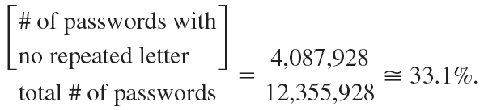
Example 9.3.3 – Solution
continued
d. Given the assumption that all passwords are equally likely, the equally likely probability formula can be used. So the probability that a randomly chosen password has at least one repeated letter is

Slide 26
The Inclusion/Exclusion Rule

Slide 27
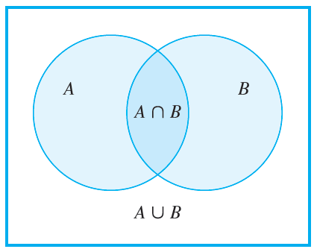
The Inclusion/Exclusion Rule
The addition rule says how many elements are in a union of sets if the sets are mutually disjoint. Now consider the question of how to determine the number of elements in a union of sets when some of the sets overlap. For simplicity, begin by looking at a union of two sets A and B, as shown in Figure 9.3.5.
Figure 9.3.5

Slide 28
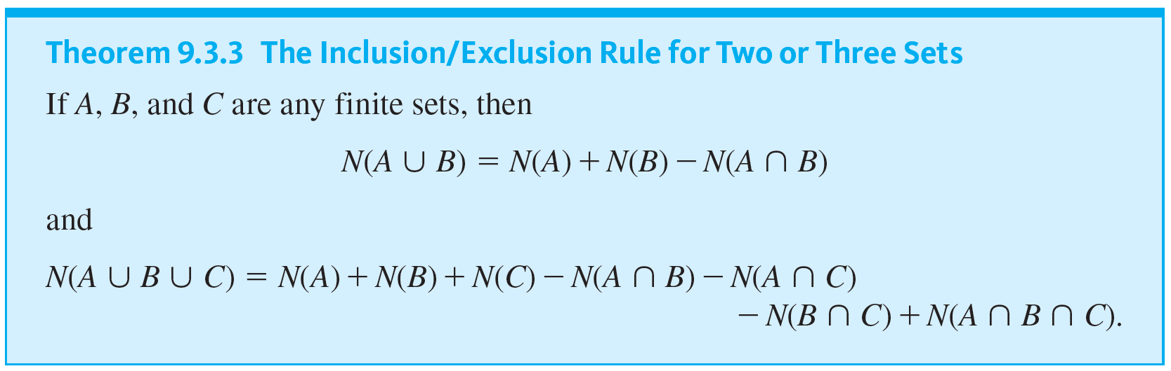
The Inclusion/Exclusion Rule

Slide 29
Example 9.3.6 – Counting Elements of a General Union
a. How many integers from 1 through 1,000 are multiples of 3 or multiples of 5?
b. How many integers from 1 through 1,000 are neither multiples of 3 nor multiples of 5?

Slide 30
Example 9.3.6 – Solution
a. Let A = the set of all integers from 1 through 1,000 that are multiples of 3.
Let B = the set of all integers from 1 through 1,000 that are multiples of 5.
Then
A ∪ B = the set of all integers from 1 through 1,000 that are multiples of 3 or multiples of 5
and
A ∩ B = the set of all integers from 1 through 1,000 that are multiples of both 3 and 5

Slide 31
Example 9.3.6 – Solution
continued
= the set of all integers from 1 through 1,000 that are multiples of 15.
[Now calculate N(A), N(B), and N(A ∩ B) and use the inclusion/exclusion rule to solve for N(A ∪ B).]
Because every third integer from 3 through 999 is a multiple of 3, each can be represented in the form 3k, for some integer k from 1 through 333.

Slide 32
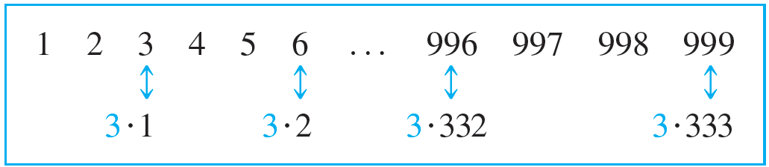
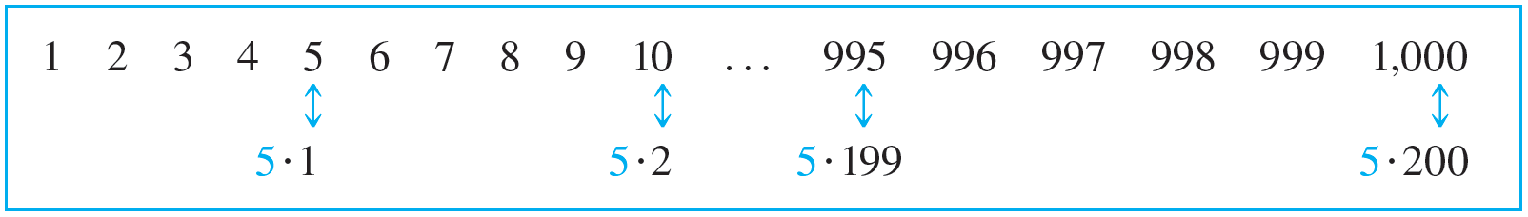
Example 9.3.6 – Solution
continued
Hence there are 333 multiples of 3 from 1 through 1,000, and so N(A) = 333.
Similarly, each multiple of 5 from 1 through 1,000 has the form 5k, for some integer k from 1 through 200.

Slide 33
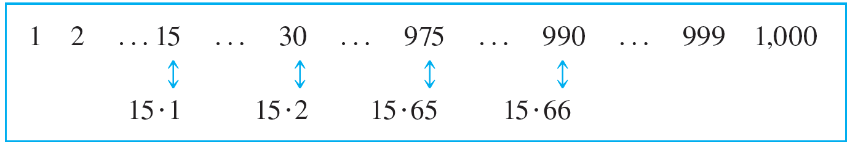
Example 9.3.6 – Solution
continued
Thus there are 200 multiples of 5 from 1 through 1,000 and N(B) = 200. Finally, each multiple of 15 from 1 through 1,000 has the form 15k, for some integer k from 1 through 66 (since 990 = 66 · 15).
Hence there are 66 multiples of 15 from 1 through 1,000, and N(A ∩ B) = 66.

Slide 34
Example 9.3.6 – Solution
continued
It follows by the inclusion/exclusion rule that
N(A ∪ B) = N(A) + N(B) + N(A ∩ B)
= 333 + 200 − 66
= 467.
Thus, 467 integers from 1 through 1,000 are multiples of 3 or multiples of 5.

Slide 35
Example 9.3.6 – Solution
continued
b. There are 1,000 integers from 1 through 1,000, and by part (a), 467 of these are multiples of 3 or multiples of 5.
Thus, by the set difference rule, there are 1,000 − 467 = 533 that are neither multiples of 3 nor multiples of 5.

